Slide 1
Introduction to Computer Simulation of Physical Systems (Lecture 5)
PHYS 3061

Slide 2
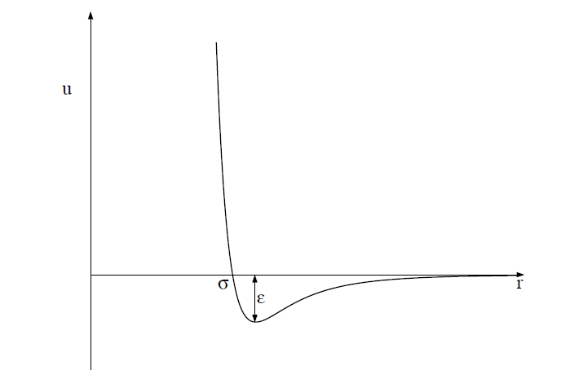
One of the most common phenomenological forms of u(r) is the Lennard-Jones potential:
u(r) = 4ϵ[(σ/r)¹²−(σ/r)⁶].

Slide 3
The r ⁻¹² form of the repulsive part of the interaction was chosen for convenience only and has no fundamental significance.
The attractive 1/r⁶ behavior at large r corresponds to the van der Waals interaction.
The Lennard-Jones potential is parameterized by a length σ and an energy ϵ.
Note that u(r) = 0 at r = σ, and that u(r) is close to zero for r > 2.5σ.
The parameter ϵ is the depth of the potential at the minimum of u(r); the minimum occurs at a separation r = 2^{1/6} σ.

Slide 4
Units
convenient to choose units
the computed quantities are neither too small nor too large.
What’s the problem of being too small or too large?
Because the values of the distance and the energy associated with typical liquids are very small in SI units,
What’s the typical value for distance and energy?
we can choose the Lennard-Jones parameters σ and ϵ as the units of distance and energy, respectively.
We can also choose the unit of mass to be the mass of one atom, m. We can express all other quantities in terms of σ, ϵ, and m.

Slide 5
For example, we can measure velocities in units of (ϵ/m)^{1/2},
and the time in units of σ(m/ϵ)^{1/2}.
The values of σ, ϵ, and m for argon are given in the next page.
If we use these values, we find that the unit of time is 2.17×10⁻¹² s.
The units of some of the other physical quantities of interest also are shown in next page.

Slide 6
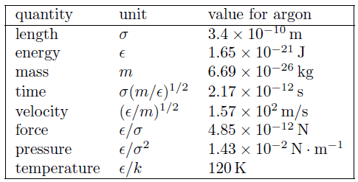
The system of units used in the molecular dynamics simulations of particles interacting via the Lennard-Jones potential. The numerical values of σ, ϵ, and m are for argon. The quantity k is Boltzmann’s constant and has the value k = 1.38 × 10⁻²³ J/K. The unit of pressure is for a two-dimensional system.

Slide 7
All program variables are in reduced units,
for example, the time in our molecular dynamics program is expressed in units of σ(m/ϵ)^{1/2}.
Suppose that we run our molecular dynamics program for 2000 time steps with a time step Δt = 0.01.
The total time of our run is 2000 × 0.01 = 20 in reduced units or 4.34 × 10⁻¹¹ s for argon.

Slide 8
The duration of a typical molecular dynamics simulation is in the range of 10–10⁴ in reduced units, corresponding to a duration of approximately 10⁻¹¹–10⁻⁸ s. The longest practical runs are the order of 10⁻⁶ s.

Slide 9
The Numerical Algorithm
we need to introduce a numerical method for computing the trajectory of each particle.
The criteria for a good numerical integration method include that
it conserves the phase-space volume and be consistent with the known conservation laws, is time reversible, and is accurate for relatively large time steps to reduce the CPU time needed for the total time of the simulation.

Slide 10
We should use an algorithm for the relatively long time of interest in molecular dynamics simulations!
We adopt the commonly used second-order algorithm:
x_{n+1} = x_{n} + v_{n}Δt +1/2a_{n}(Δt)²
v_{n+1} = v_{n} +1/2(a_{n+1} + a_{n})Δt.

Slide 11
The new position is used to find the new acceleration a_{n+1},
used together with a_{n} to obtain the new velocity v_{n+1}.
The algorithm is known as the Verlet (or sometimes the velocity Verlet) algorithm.
The sample code will use Verlet implementation of the ODESolver interface to implement the algorithm.
Thus, the x, v_{x}, y, and v_{y} values for the ith particle will be stored in the state array at state[4*i], state[4*i+1], state[4*i+2], and state[4*i+3], respectively.
In your own code, you can just implement Verlet by yourself with the help of global arrays of position, velocities, and forces along each directions.

Slide 12
Periodic Boundary Conditions
A useful simulation must incorporate as many of the relevant features of the physical system of interest as possible.
Usually we want to simulate a gas, liquid, or a solid in the bulk, that is, systems of at least N ∼ 10²³ particles.
What’s the approximate number of particles on the surface? A rough estimation.
In such systems the fraction of particles near the walls of the container is negligibly small.

Slide 13
The number of particles that can be studied in a molecular dynamics simulation is typically 10³–10⁵,
although we can simulate the order of 10⁹ particles using clusters of computers.
If you are interested, try to learn parallel computing on our department cluster!
For these relatively small systems, the fraction of particles near the walls of the container is significant, and hence the behavior of such a system would be dominated by surface effects.

Slide 14
The most common way of minimizing surface effects and to simulate more closely the properties of a bulk system is to use what are known as periodic boundary conditions,
although the minimum image approximation would be a more accurate name.

Slide 15
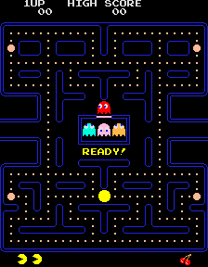
This boundary condition is familiar to anyone who has played the Pacman computer game!
Consider N particles that are constrained to move on a line of length L.
The application of periodic boundary conditions is equivalent to considering the line to be a circle, and hence the maximum separation between any two particles is L/2.

Slide 16
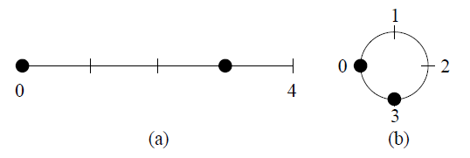
The generalization of periodic boundary conditions to two dimensions is equivalent to imagining a box with opposite edges joined so that the box becomes the surface of a torus (the shape of a doughnut or a bagel).
The three-dimensional version of periodic boundary conditions cannot be visualized easily, but the same methods can be used.
(a) Two particles at x = 0 and x = 3 on a line of length L = 4; the distance between the
particles is 3.
(b) The application of periodic boundary conditions for short range interactions is
equivalent to thinking of the line as forming a circle of circumference L.
In this case the minimum distance between the two particles is 1.

Slide 17
The implementation of periodic boundary conditions is straightforward.
If a particle leaves the box by crossing a boundary in a particular direction, we add or subtract the length L of the box in that direction to the position.
Translational symmetry vs. rotational symmetry.

Slide 18
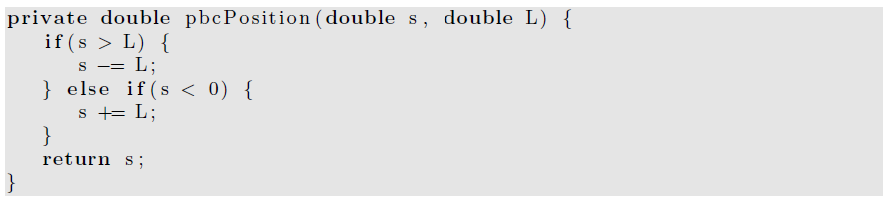
Calculation of the position of particle in the central cell.

Slide 19
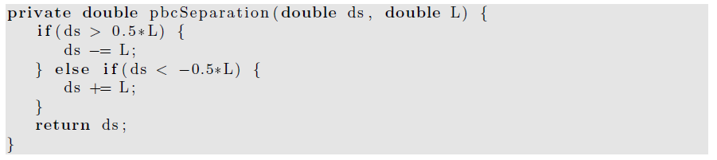
To compute the minimum distance ds in a particular direction between two particles, we can use the method pbcSeparation.

Slide 20
The nature of periodic boundary conditions.
Imagine a set of N particles in a two-dimensional box or cell.
The use of periodic boundary conditions implies that the central cell is duplicated an infinite number of times to fill the space.

Slide 21
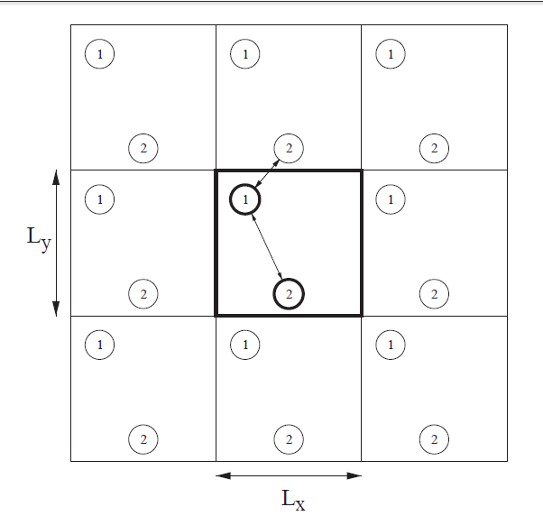
the first several image cells for N = 2.
The shape of the central cell must be such that the cell fills space under successive translations.
Each image cell contains the original particles in the same relative positions as the central cell.

Slide 22
Periodic boundary conditions yield an infinite system!
although the positions of the particles in the image cells are identical to the positions of the particles in the central cell.
These boundary conditions also imply that every point in the cell is equivalent and that there is no surface.

Slide 23
As a particle moves in the original cell,
its periodic images move in the image cells.
Hence only the motion of the particles in the central cell needs to be followed.
When a particle enters or leaves the central cell,
the move is accompanied by an image of that particle leaving or entering a neighboring cell through the opposite face.

Slide 24
The total force on a given particle i is due to the force from every other particle j within the central cell and from the periodic images of particle j.
That is, if particle i interacts with particle j in the central cell, then particle i interacts with all the periodic replicas of particle j.
Big trouble, the total force may not even converge with system sizes.
Any such examples with a long range interaction to show such kind of divergence feature?

Slide 25
There are an infinite number of contributions to the force on any given particle!
For long-range interactions such as the Coulombic potential, these contributions have to be included using special methods.

Slide 26
For short-range interactions, we can reduce the number of contributions by adopting the minimum image approximation,
which assumes that particle i in the central cell interacts only with the nearest image of particle j;
the interaction is set equal to zero if the distance of the image from particle i is greater than L/2.

Slide 27
A Molecular Dynamics Program
In this section, we demonstrate a molecular dynamics program to simulate a two-dimensional system of particles interacting via the Lennard-Jones potential.
We choose two rather than three dimensions because it is easier to visualize the results and the calculations are not as time consuming.
In the lab, you will be asked to write a code to simulate 3D with fixed boundaries.

Slide 28
In principle, we could define a class for a particle, and instantiate an object for each particle.
However, this use would be very inefficient and would take up more memory and CPU time than using one class to represent all N particles.
Instead we will store the x- and y-components of the positions and velocities in the state array and store the accelerations of the particles in a separate array.
OOP is always more expensive!
We will develop two classes, LJParticles and LJParticlesApp.

Slide 29
Because the system is deterministic, the nature of the motion is determined by the initial conditions.
According to the equipartition theorem, the mean kinetic energy of a particle per degree of freedom is kT/2,
where k is Boltzmann’s constant and T is the temperature.

Slide 30
We can generalize this relation to define the temperature at time t by
k_{B}T(t) =2K(t)/ (d N) =1/(N d) * Σ [m_{i}v_{i}(t) · v_{i}(t)],
where i is from 1 to N. K is the total kinetic energy of the system, v_{i} is the velocity of particle i with mass m_{i}, and d is the spatial dimension of the system.

Slide 31
The following method gives the particles a random set of velocities, sets the total velocity (momentum) to zero, and then rescales the velocities so that the desired initial kinetic energy is achieved.

Slide 32
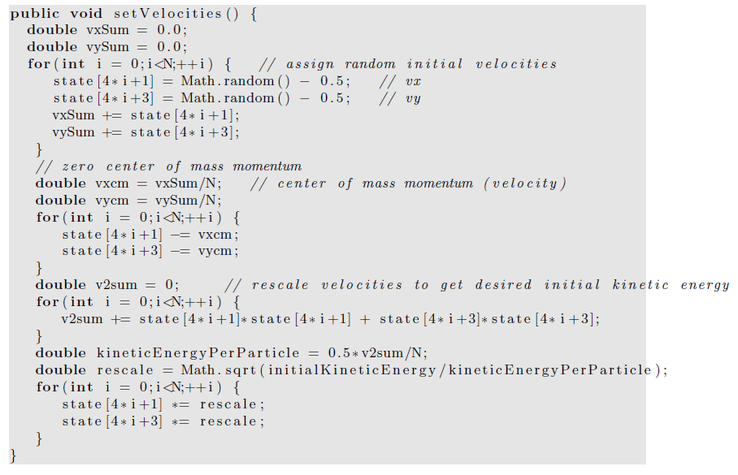

Slide 33
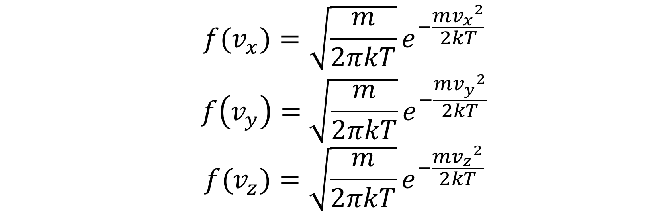
Initialization with Maxwell Boltzmann distribution
One problem of the textbook code,
It give a uniform distribution of velocity.
The speed with Maxwell Boltzmann distribution,
Equivalently, the one-dimensional velocity satisfies Gaussian distribution,

Slide 34
Convert uniform distribution to other distributions
For Gaussian distribution, direct conversion (Box-Muller method) may be used,
For general distribution, Monte Carlo method should be used
(If you are interested in Monte Carlo method , some of the contents will be covered later this semester and more advanced materials will be covered in
PHYS4061 Computational Physics)

Slide 35
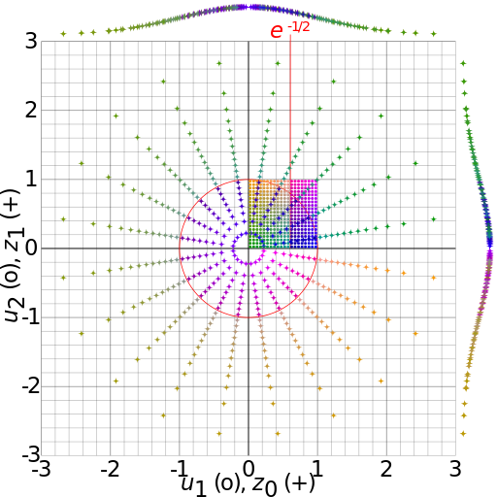

Convert uniform distribution to Gaussian distribution
Box-Muller transform,
Where
ϑ1, ϑ2 are independent random numbers, 0 < ϑ1, ϑ2 < 1
x1, x2 are independent random numbers with standard normal distribution
https://en.wikipedia.org/wiki/Box–Muller_transform#/media/File:Box-Muller_transform_visualisation.svg

Slide 36
Maxwell Boltzmann distribution
After getting the one-dimensional velocity, which satisfies
Simply, get the velocity by

Slide 37
We will find that setting the initial velocities so that the initial temperature is the desired value
does not guarantee that the system will maintain this temperature when it reaches equilibrium.
Why?
Determining an initial configuration that satisfies the desired conditions is an iterative process.

Slide 38
If the system is a dilute gas, we can choose the initial positions of the particles by placing them at random,
making sure that no two particles are too close to one another.
If two particles were too close, they would exert a very large repulsive force F on one another
any simple finite difference integration method would break down because the condition (F/m)(Δt)² ≪ σ would not be satisfied.
(In dimensionless units, this condition is F(Δt)² ≪ 1.)

Slide 39
If we assume that the separation between two particles is greater than 2^{1/6}σ,
this condition is satisfied.
The following method places particles at random such that no two particles are closer than 2^{1/6}σ.
Note that we use a do/while statement to insure that the body of the loop is executed at least once!

Slide 40
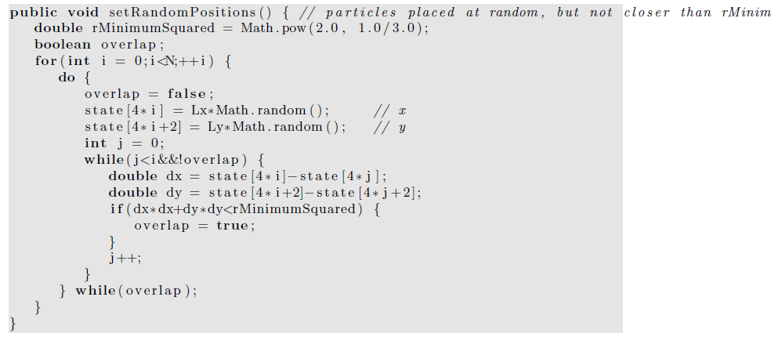

Slide 41
Any problems with this algorithm?
Any solutions?

Slide 42
Finding a random configuration of particles in which no two particles are closer than 2^{1/6}σ becomes much too inefficient if the system is dense.
It is possible to choose the initial positions randomly without regard to their separations if we include a fictitious drag force proportional to the square of the velocity.

Slide 43
The effect of such a force is to dampen the velocity of those particles whose velocities become too large due to the large repulsive forces exerted on them.
We then would have to run for a while until all the velocities satisfy the condition vΔt ≪ 1.
As the velocities become smaller, we may gradually reduce the friction coefficient.

Slide 44
In general, the easiest way of obtaining an initial configuration with the desired density is to place the particles on a regular lattice.
If the temperature is high or if the system is dilute, the system will “melt” and become a liquid or a gas; otherwise, it will remain a solid.

Slide 45
If our goal is to equilibrate the system at fluid densities, it is not necessary to choose the correct equilibrium symmetry of the lattice.
The method setRectangularLattice places the particles on a rectangular lattice.
To make the method simple, the user must specify the number of particles per row, nx, and the number per column, ny.

Slide 46
The linear dimensions Lx and Ly are adjustable parameters and can be varied after initialization to be as close as possible to their desired values.
In this way we can vary the density by varying the volume (area) without setting up a new initial configuration.

Slide 47
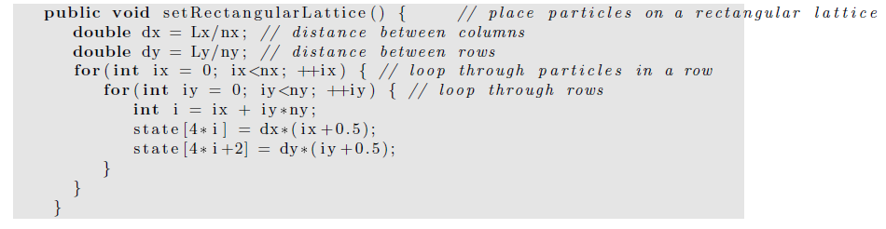

Slide 48
computation of the accelerations of the particles.
The most time consuming part of MD.
The method computeAcceleration determines the total force on each particle
due to the other N −1 particles
uses Newton’s third law to reduce the number of calculations by a factor of two.

Slide 49
For a system of N particles, there are a total of N(N −1)/2 possible interactions.
Because of the short range nature of the Lennard-Jones potential, we could truncate the force at r = rc and ignore the forces from particles whose separation is greater than rc.
However, for N < 400, it is easier to include all possible interactions, no matter how small.

Slide 50
The quantity virial accumulated in computeAcceleration will be discussed later,
We will see that it is related to the pressure.
It is convenient to also calculate the potential energy in computeAcceleration.
Note that in reduced units, the mass of a particle is unity, and hence the acceleration and force are equivalent.

Slide 51
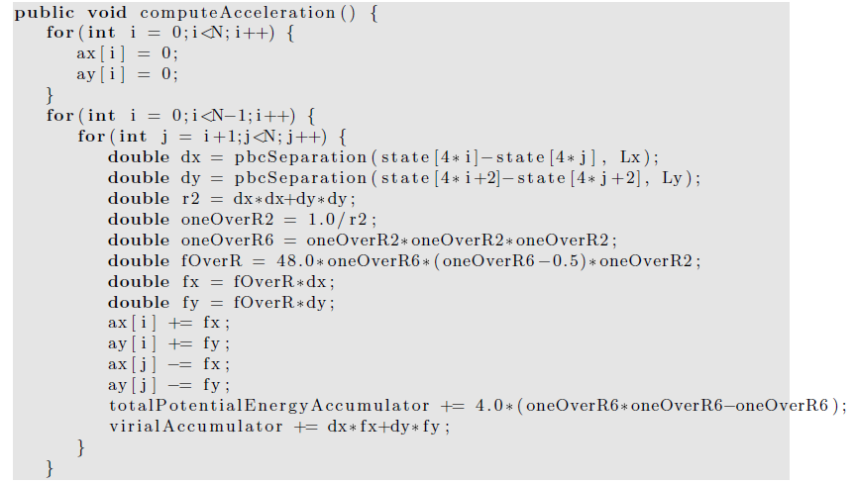
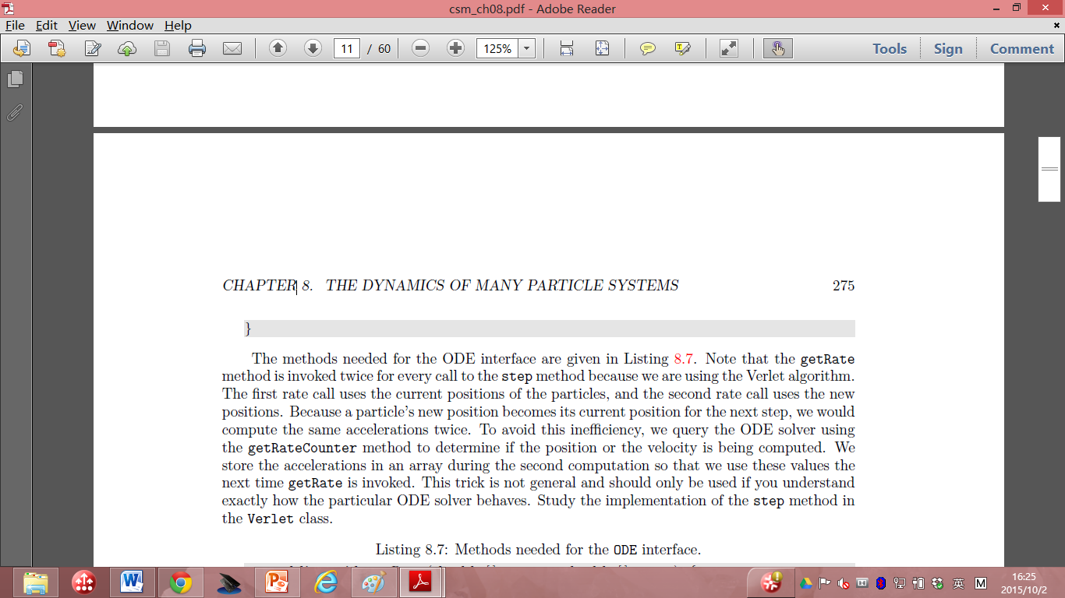

Slide 52
The methods needed for the ODE interface are given in next few pages.
Note that the getRate method is invoked twice for every call to the step method because we are using the Verlet algorithm.
The first rate call uses the current positions of the particles, and the second rate call uses the new positions.

Slide 53
Because a particle’s new position becomes its current position for the next step, we would compute the same accelerations twice in Verlet.
Any solutions?

Slide 54
To avoid this inefficiency, we query the ODE solver using the getRateCounter method to determine if the position or the velocity is being computed.
We store the accelerations in an array during the second computation so that we use these values the next time getRate is invoked.
This trick is not general and should only be used if you understand exactly how the particular ODE solver behaves.

Slide 55
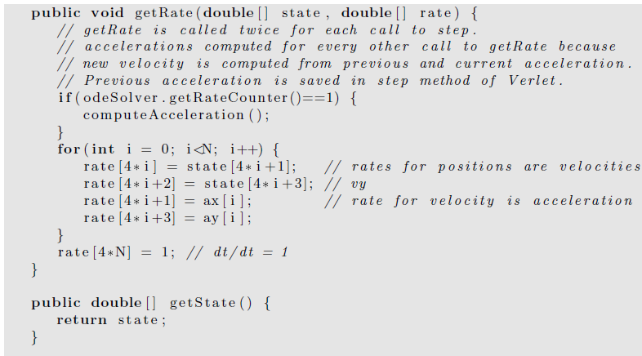

Slide 56
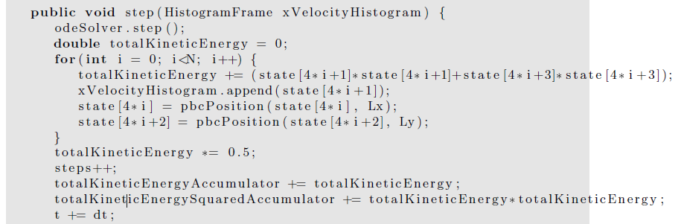
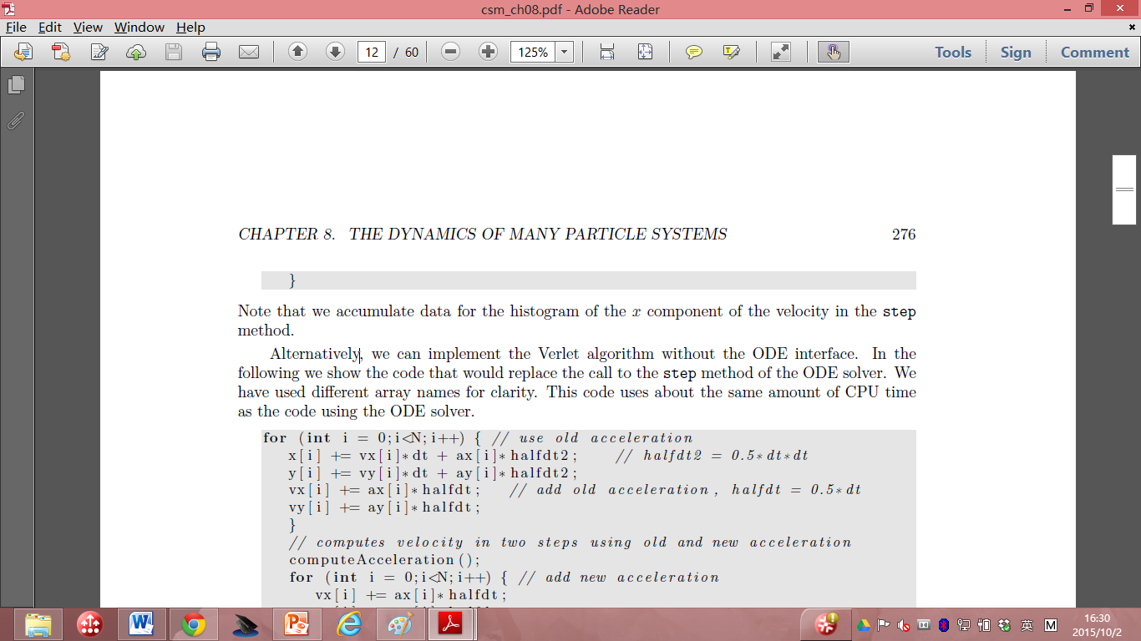

Slide 57
Note that we accumulate data for the histogram of the x component of the velocity in the step method.
Alternatively, we can implement the Verlet algorithm without the ODE interface.
In the following we show the code that would replace the call to the step method of the ODE solver.
We have used different array names for clarity.
This code uses about the same amount of CPU time as the code using the ODE solver.

Slide 58
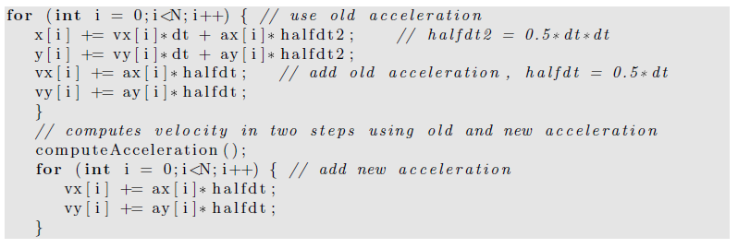
In next page, we give some of the methods for computing the temperature, pressure (details will be covered later), and the heat capacity (also covered later).
The mean total energy should remain constant, but we compute it to test how well the algorithm conserves the total energy.

Slide 59
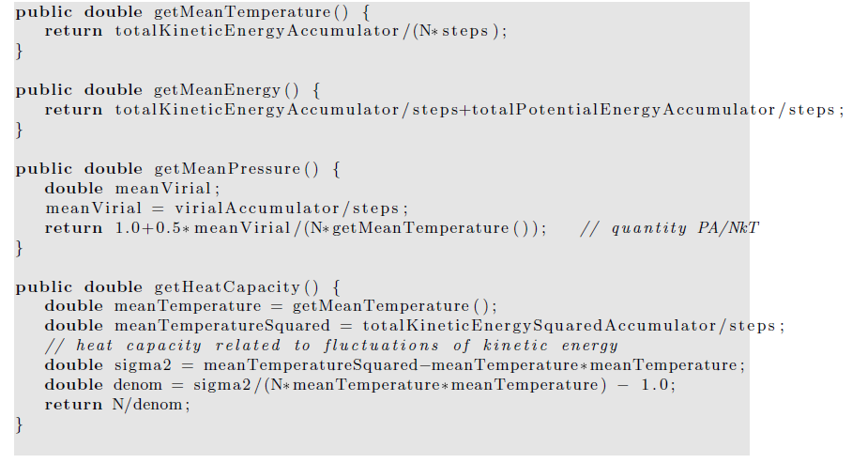

Slide 60
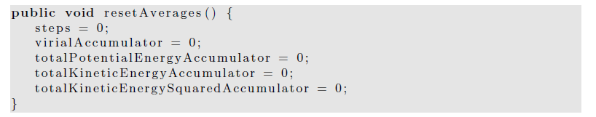
The resetAverages method is used to set the accumulated averages to zero so that the initial transient behavior can be removed from the computed averages.

Slide 61
a time consuming part of a molecular dynamics simulation is equilibrating the system, especially at high densities.
The quickest way to do so is to start with a configuration that is typical of the configurations at the desired energy and density.

Slide 62
Hence, we will want to be able to read the positions and velocities of the particles from a previously saved file.
For the GUI code, please read the text book if you are interested.

